Slide 1
ADC
Analog to Digital Converter

Slide 2
Conversion process
3 steps:
Sampling
Quantification
Coding
These operations are all performed in a same element called the A to D Converter

Slide 3
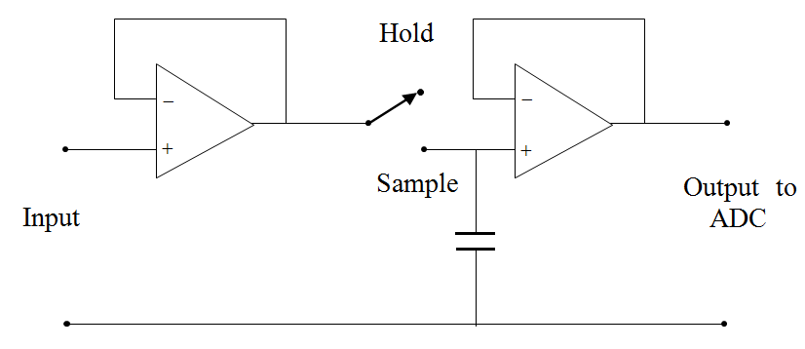
Conversion process: Sampling
To measure an AC voltage at a particular instant in time, it is necessary to sample the waveform with a ‘sample and hold’ (S/H) circuit.

Slide 4
Types of ADCs
Flash ADC
Dual slope converter
Successive approximation converter
Sigma-delta ADC

Slide 5
3 Bit Flash ADC
V
7V/8
Analog In
6V/8
Priority Encoder
5V/8
Digital Out
V/2
3V/8
2V/8
Enable
1V/8
Number of Op-Amps 2^{n}-1

Slide 6
Flash ADC
Let’s start design of a 2-bit flash ADC for resolution of 0.25V
Number of OP-Amp Required : 2^{n}-1
The reference voltage required:
Vref = Resolution * 2^{n}
Reference voltage = 0.25*4 = 1V

Slide 7
Flash ADC
Analog input Voltage (Vi) | Comparator outputs |  |  | Digital Outputs
 | C1 | C2 | C3 | B1 | B0
0 ≤ Vi ≤ V/4 | 0 | 0 | 0 | 0 | 0
V/4 ≤ Vi ≤ V/2 | 1 | 0 | 0 | 0 | 1
V/2 ≤ Vi ≤ 3V/4 | 1 | 1 | 0 | 1 | 0
3V/4 ≤ Vi ≤ V | 1 | 1 | 1 | 1 | 1
Logic expression for b0 and b1.

Slide 8
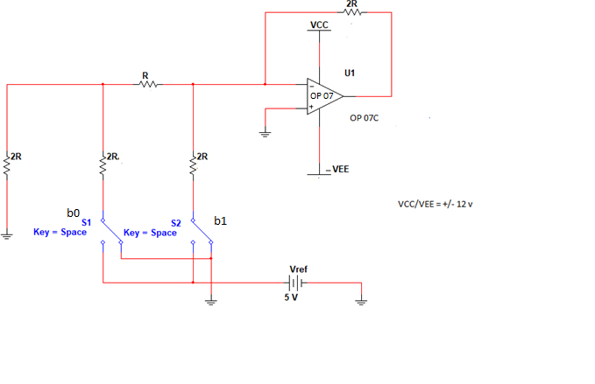

Vo = $Vref∗\left(b1{∗2}^{−1}+b0∗2^{−2}\right)$

Slide 10
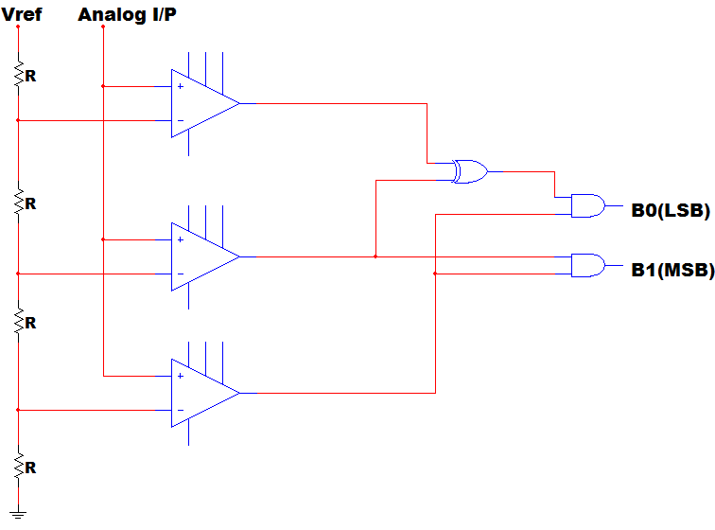
Flash ADC
3V/4
V/2
V/4

Slide 11
Flash ADC
Advantages
Flash ADCs are very fast and can convert data at high frequencies.
Disadvantages
The major disadvantage to flash ADCs is the complexity of the circuits.
an 8-bit Flash ADC requires 255 op amps
a 12-bit Flash ADC requires 4095 op amps
a 16-bit flash ADC requires 65,535 op amp
High Cost (Major factor over 6 bits)

Slide 12
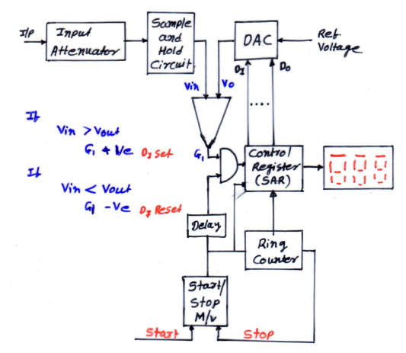
Successive Approximation

Slide 13
Successive Approximation ADC
If Vin = 1V
SET | D3 | D2 | D1 | D0 | Voltage | Compare | Bit Set/Reset
 | 2.5 | 1.25 | 0.625 | 0.312
D3 | 1 | 0 | 0 | 0 | 2.5V | Vin < Vout | D3 Reset
D2 | 0 | 1 | 0 | 0 | 1.25 | Vin < Vout | D2 Reset
D1 | 0 | 0 | 1 | 0 | 0.625 | Vin > Vout | D1 Set
D0 | 0 | 0 | 1 | 1 | 0.9375 | Vin > Vout | D0 Set
Final conversion of 1V is 0011

Slide 14
Successive Approximation
1000
1100
1111
1001
0100
0111
0001
1110
1101
1010
1011
0010
0011
0110
0101
1110
1100
1010
1000
0110
0100
0010
0000

Slide 15
Successive Approximation
Advantages
Capable of high speed
Medium accuracy compared to other ADC types
Good tradeoff between speed and cost
Disadvantages
Higher resolution
Relatively slower than Flash ADC
Speed limited ~5Msps

Slide 16
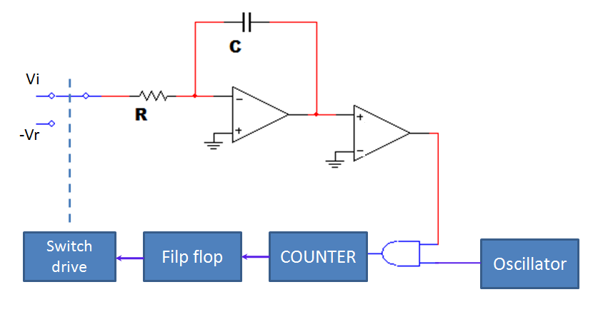
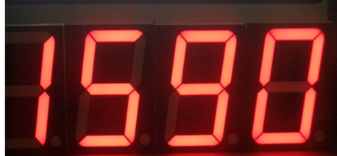
Dual Slope converter
Control
Circuit

Slide 17
Dual Slope converter (Voltage to time conversion)
Principle: Measure the time of positive slope of integrator output proportional to test input voltage and negative slope of integrator output proportional to negative reference voltage.
V
Slope proportional to input
Slope proportional to reference.
time
t
t1
Capacitor cycle
Charge
Discharge
Counter cycle
Counts from
0 to Max
Final count display

Slide 18
Dual Slope converter
During Charging
T=Time period of oscillator
t = n₁T constant
t₁= n₂T
During Discharging

Slide 19
Dual Slope converter
Consider clock frequency : 1MHz
Reference voltage : - 1V
The fixed time period (t) : 1mS
Unknown input voltage : 5V
During the fixed time period (t)

Slide 20
Dual Slope converter
Advantages
Greater noise immunity by process of integration
High resolution [8-10bits]
Excellent accuracy (input voltage is independent of the integrator time constant]
Low cost
Disadvantages
Slow speed
High precision external components required to achieve accuracy

Slide 21
Comparison
Type of ADC | Speed | Price | Noise Immunity | Conversion Time
Dual slope | ☹☹☹ | ☺☺ | ☺☺☺ | Vary (2*2^{n}) tclk
Successive approximation | ☺☺☺ | ☹ | ☹ | Constant No. of bits * tclk
Parallel / flash | ☺☺☺☺☺ | ☹☹☹☹☹ Not feasible for high resolution | ☹ | Constant Single tclk

Slide 22
Calculate the maximum conversion time of a 8-bit successive approximation ADC, if the clock rate is 2MHz.
Solution:
For a 8-bit successive approximation ADC, the conversion time is constant and equal to

